Slide 1
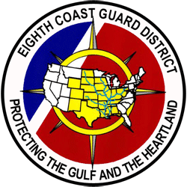
Eighth Coast Guard District
Commercial Fishing Vessel Safety (CFVS) Program

Slide 2
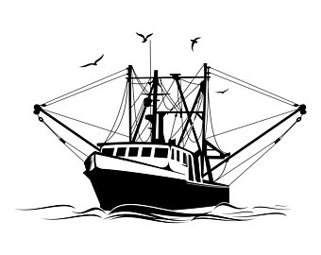
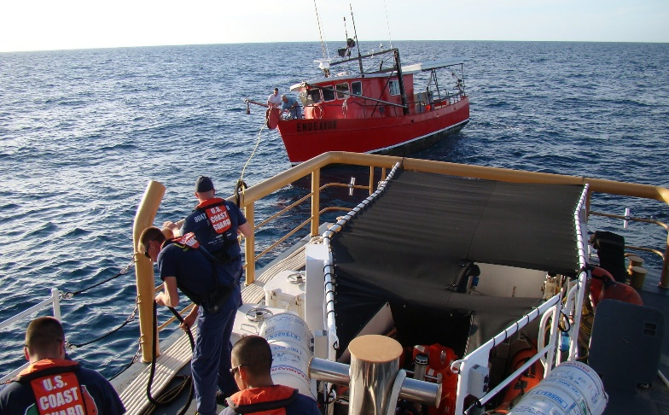
Objective
CFVS Program serves to promote safe operating practices and regulatory compliance through vessel examinations and various outreach initiatives through engagement and partnership with our commercial fishing communities.
Eighth Coast Guard District
Commercial Fishing Vessel Safety Program

Slide 3
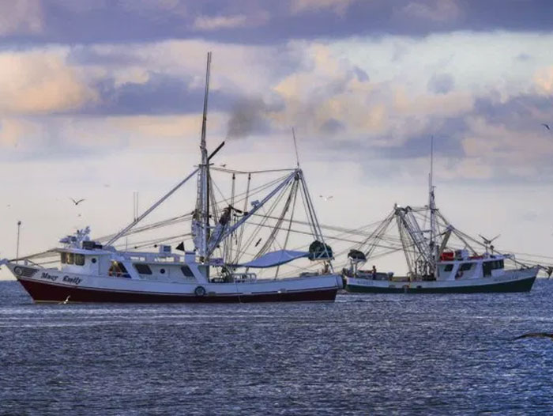
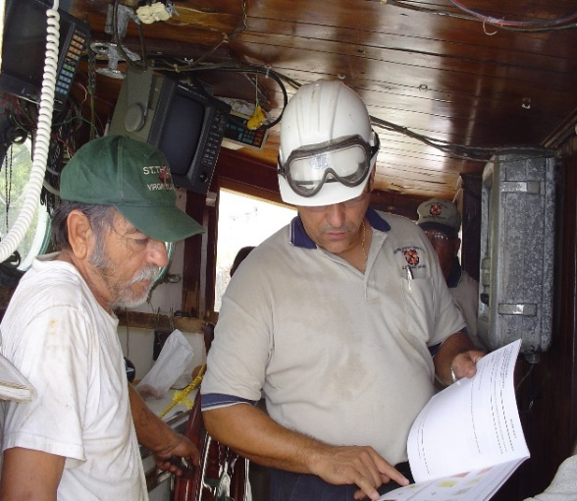
Priorities
With one CFVS Coordinator & 11 Examiners in D8, we aim to reduce/eliminate preventable deaths, injuries & casualties, through outreach, long standing partnerships and education.
Seek safety exam opportunities to engage CFV Communities to share best safe practices and ensure compliance with applicable Regulations.
Update MISLE Data assuring accurate contact identification to assist CCs prosecuting SAR (EPIRBs) cases or other missions.

Slide 4
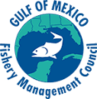
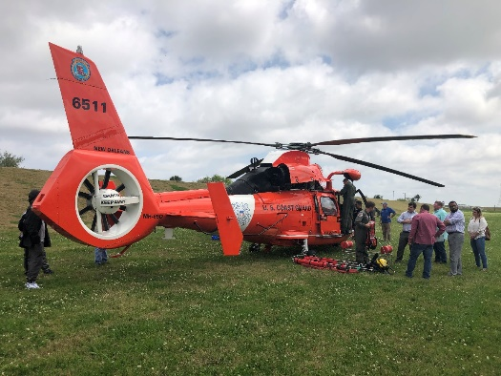
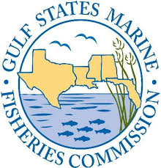
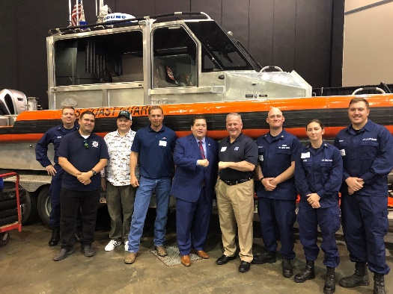
Initiatives
Sponsoring Fishing Industry Expos
Active Participants at the Gulf of Mexico Fisheries Management Council Meetings.
Participation with CFV Industry to share the importance of CFVS at Louisiana Marine Expo. Next Sked: March 2023 in Kenner, Louisiana.
Active partners with the Gulf States Marine Fisheries Commission.
Excellent opportunity for Fishers to share perspectives with attending participants as well as Louisiana’s Lieutenant Governor

Slide 5
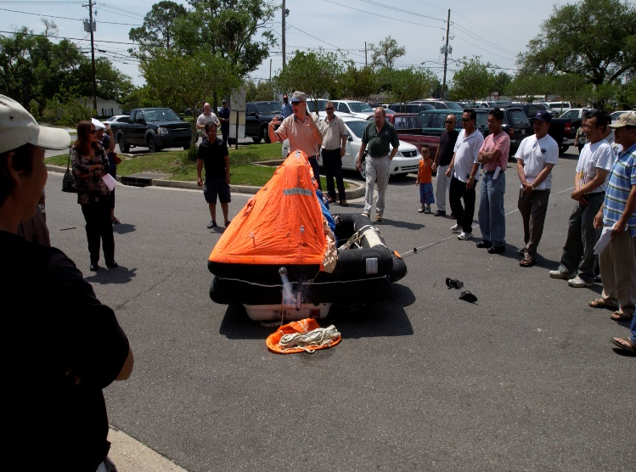
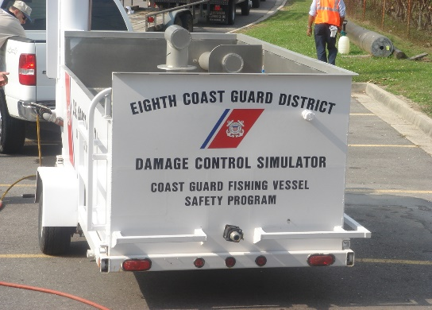
Initiatives (Con’t)
Partner w/Sea Grant and Universities conducting studies of safety equip & measures.
Engage Spanish/Vietnamese communities to identify translation resources to address communication challenges.
National Communications Plan.
High Risk CFVs.
Educate GRFTC Students (BOs/BTMs) on CFVS Program.
Examiners frequent Stations/PBs.

